Slide 1



YourNextMeal.com
A step closer to food equity
Source: Hillside Public School
Source: EHL Insights

Slide 2
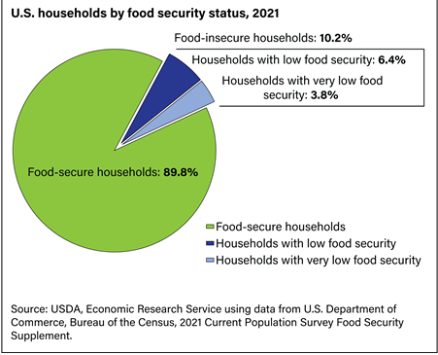

The problem
108 billion pounds of food wasted in the United States each year
$408 billion in food thrown away each year
Nearly 40% of all food in the United States
13.5 million of U.S. households suffered from food insecurity
Source:
Feeding America
U.S. Department of Agriculture

Slide 3

The solution
Our goal is to help people fulfill their urgent
food needs by establishing an ecosystem of
food donors and recipients so that food wastage
is reduced and lesser number of people sleep hungry.
“YourNextMeal.com” is a platform that will bridge
the gap between food donors and recipients so
that excess food reaches those in need via
the network of drivers or through drop-off
at food collection centers.

Slide 4
Donor & Recipient Features
Registration
Login
Registration
Login
View/Update profile
View/Update profile
Donors
Recipients
Restaurants, Grocery stores, Individuals
Individuals, Shelters, Non-profit organizations
Create donation request
View active donation requests
Edit/Cancel submitted request
Submit/ Cancel pick-up request
Locate drop-off centers
Locate pick-up centers

Slide 5
Project Milestones
Architecture & Design
Development Complete
Deployment to Production
Idea
Submission
Requirements Freeze
System Testing
Project Submission & Demo
Sep 25 | Oct 7 | Oct 14 | Oct 21 | Oct 28 | Nov 4 | Nov 11 | Nov 18 | Nov 25 | Dec 2 | Dec 4 | Dec 9

Slide 6
React
Technology Stack
Django
(AWS, terraform)
MongoDB

Slide 7
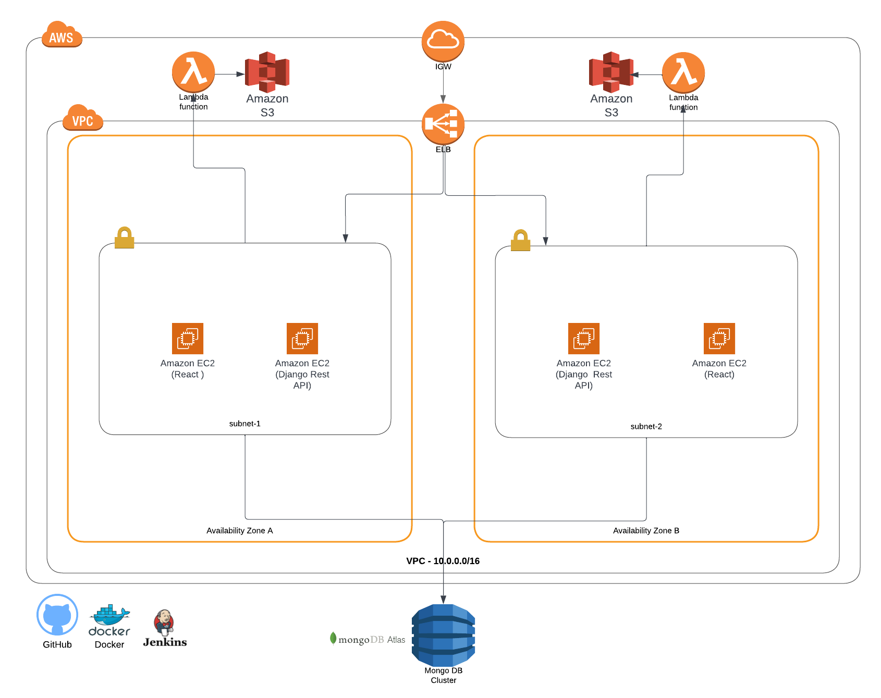
Architecture (System + Network)
Admin

Slide 8
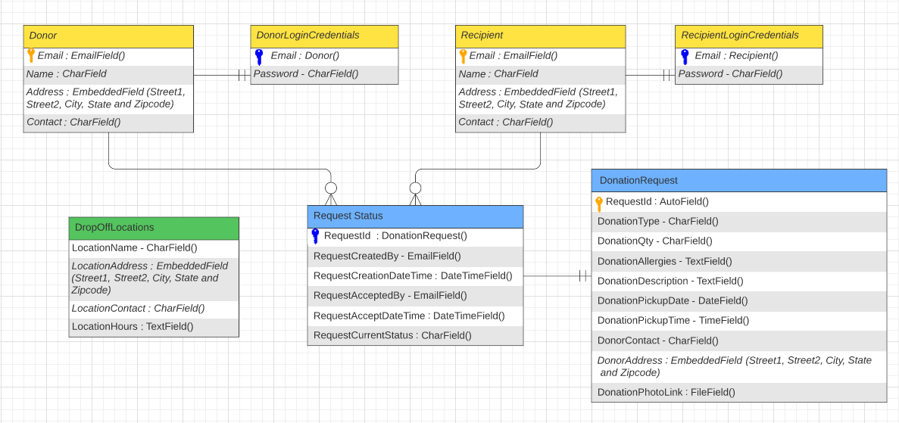
Database Schema
Admin

Slide 9
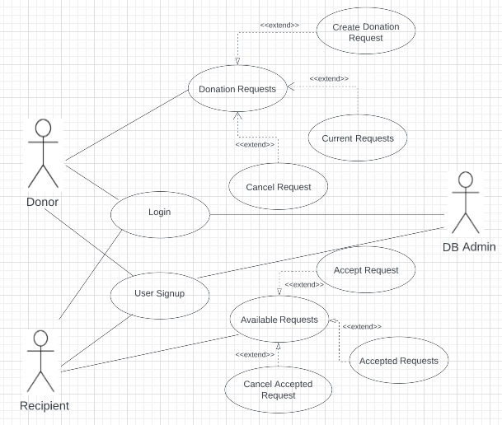
Use case Diagram
Admin

Slide 10
Conclusion & Future work
Build IOS/Android app
Track the pickup request realtime
Build a driver network with Volunteers
Donor Incentives & Analytics
Admin Features
Admin

Slide 11





The team
What we do together can make a difference.
Sanjana Kothari
Harika Satti
Naga Bathula
Ravi Teja Reddy
Siddhant Sancheti
Team Lead, Dev Engineer (Full Stack)
Dev Engineer (Full Stack)
Solution Architect, DevOps Engineer
Dev Engineer (Full Stack)
Dev Engineer (Full Stack)

